Slide 1
FY 2017 SPONSORED PROGRAMS
ANNUAL REPORT OF ACTIVITY

Slide 2
FY 2017 Award, Proposal and Expenditure Highlights
Overall Awards - $314M. 11% increase over FY16
Federal Awards - $247M. 15.8% increase over FY16
Awards for New Projects - $153M. 17.8% increase over FY16
Proposals Sent – 2,309 ($1,316M.) 3.9% (47.9%) increase over FY16
Expenditures - $338M. 1.8% increase over FY16

Slide 3
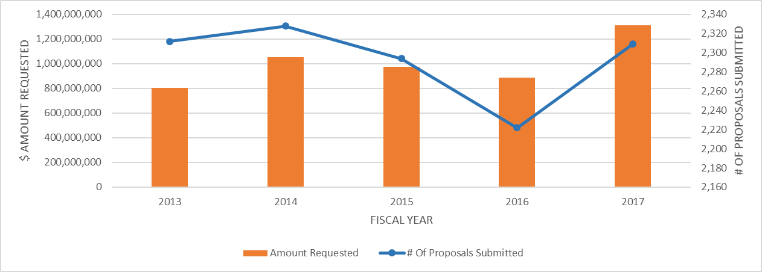
PROPOSALS SUBMITTED FOR EXTERNAL FUNDING ALL UNITS – NUMBER AND AMOUNT

Slide 4
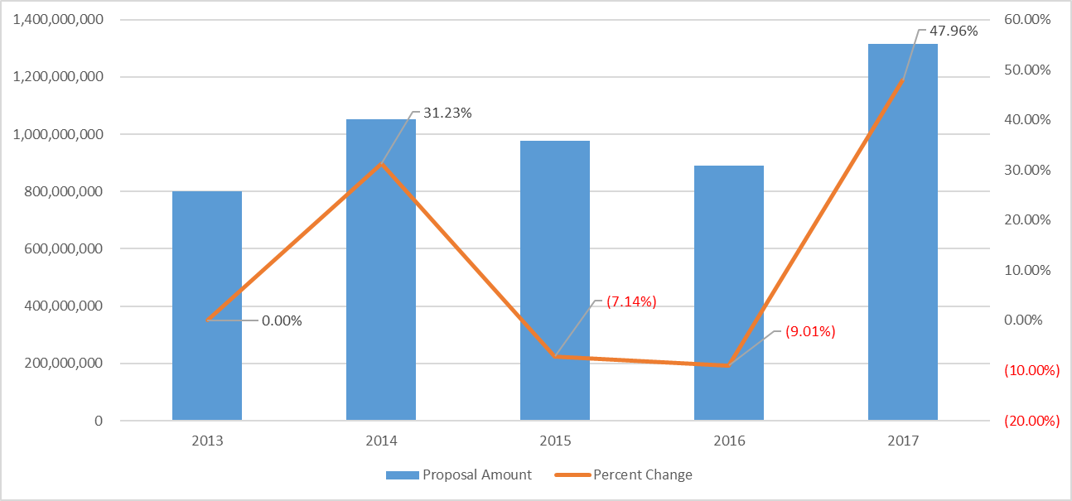
PROPOSALS SUBMITTED FOR EXTERNAL FUNDING ALL UNITS – AMOUNT AND % CHANGE

Slide 5
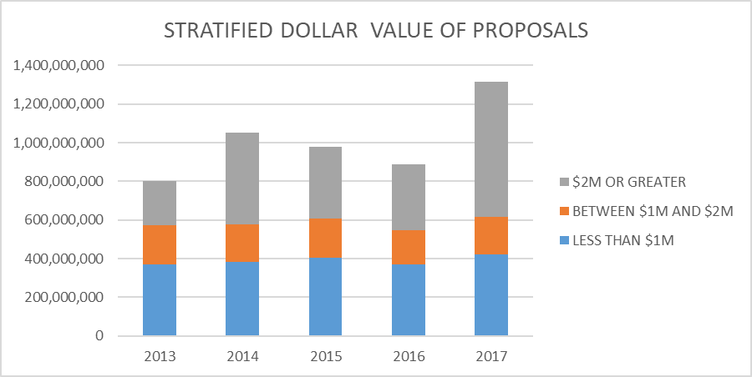
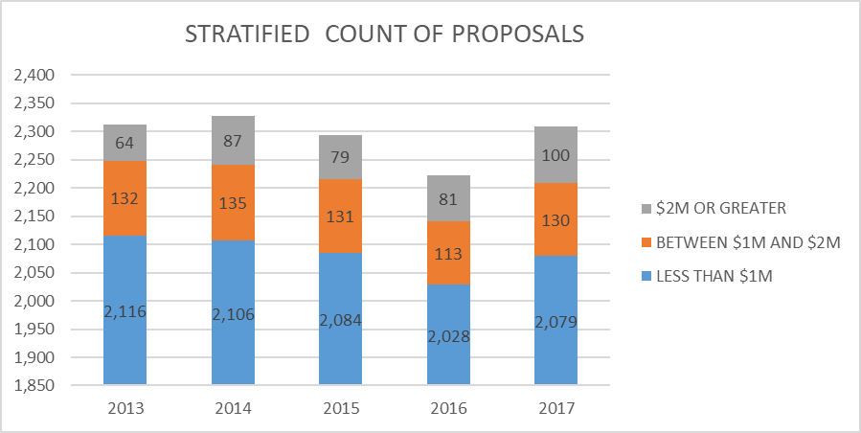
LARGE PROPOSAL ACTIVITY

Slide 6
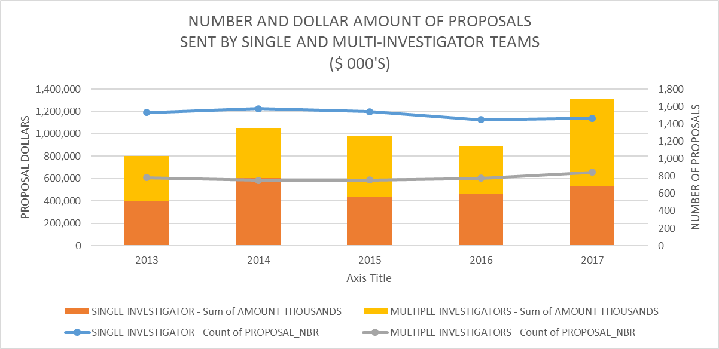
TEAM SCIENCE PROPOSAL ACTIVITY

Slide 7
PROPOSAL ACTIVITY BY COLLEGE/DIVISION
NUMBER OF PROPOSALS SENT
AMOUNT REQUESTED

Slide 8
PROPOSAL ACTIVITY AGRICULTURAL SCIENCE
NUMBER OF PROPOSALS SENT
AMOUNT REQUESTED

Slide 9
PROPOSAL ACTIVITY BUSINESS
NUMBER OF PROPOSALS SENT
AMOUNT REQUESTED

Slide 10
PROPOSAL ACTIVITY ENGINEERING, WALTER SCOTT, JR. (SCOE)
NUMBER OF PROPOSALS SENT
AMOUNT REQUESTED

Slide 11
PROPOSAL ACTIVITY LIBERAL ARTS
NUMBER OF PROPOSALS SENT
AMOUNT REQUESTED

Slide 12
PROPOSAL ACTIVITY HEALTH AND HUMAN SCIENCES
NUMBER OF PROPOSALS SENT
AMOUNT REQUESTED

Slide 13
PROPOSAL ACTIVITY NATURAL RESOURCES
NUMBER OF PROPOSALS SENT
AMOUNT REQUESTED

Slide 14
PROPOSAL ACTIVITY NATURAL SCIENCES
NUMBER OF PROPOSALS SENT
AMOUNT REQUESTED

Slide 15
PROPOSAL ACTIVITY OTHER DIVISIONS
NUMBER OF PROPOSALS SENT
AMOUNT REQUESTED

Slide 16
PROPOSAL ACTIVITY VETERINARY MEDICINE
NUMBER OF PROPOSALS SENT
AMOUNT REQUESTED

Slide 17
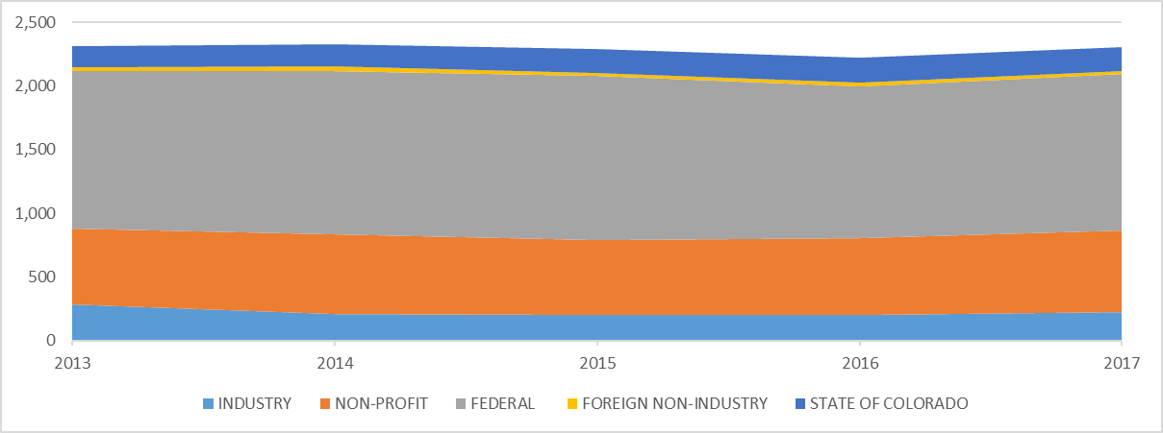
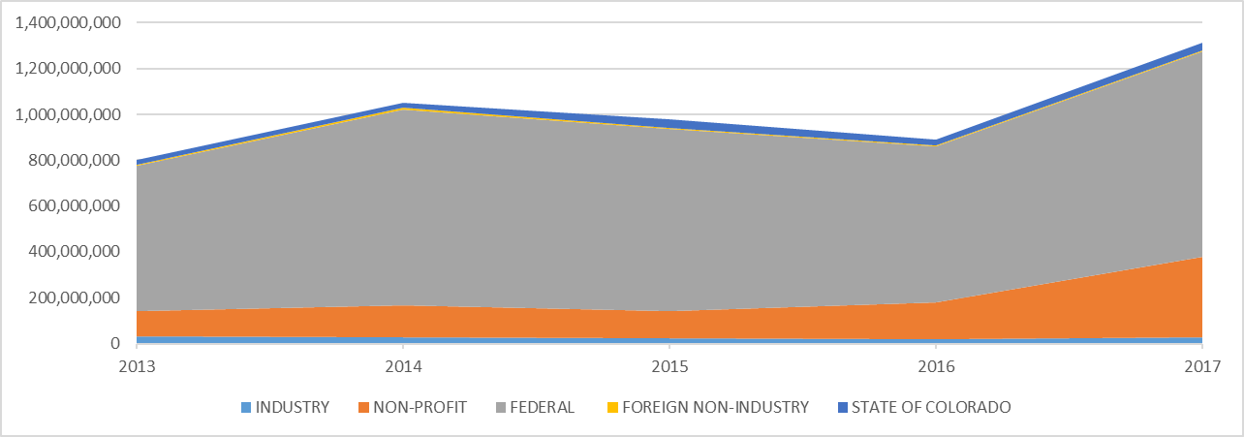
PROPOSAL ACTIVITY BY SPONSOR TYPE
NUMBER OF PROPOSALS SENT
AMOUNT REQUESTED

Slide 18
PROPOSAL ACTIVITY BY SPONSOR TYPE
TOP TEN FEDERAL SPONSORS – NUMBER OF PROPOSALS SENT
TOP TEN FEDERAL SPONSORS – DOLLAR AMOUNT OF PROPOSALS SENT

Slide 19
PROPOSAL ACTIVITY BY SPONSOR TYPE
NUMBER OF PROPOSALS SENT
AMOUNT REQUESTED

Slide 20
PROPOSAL ACTIVITY BY PROPOSAL TYPE
NUMBER OF PROPOSALS SENT
AMOUNT REQUESTED

Slide 21
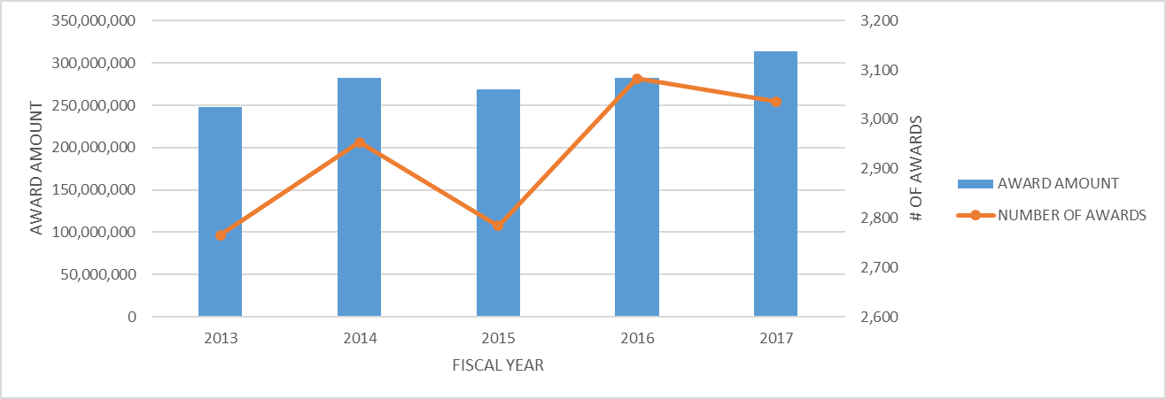
AWARDS (OBLIGATIONS) RECEIVED FROM EXTERNAL SPONSORS ALL UNITS, ALL TYPES – NUMBER AND AMOUNT

Slide 22
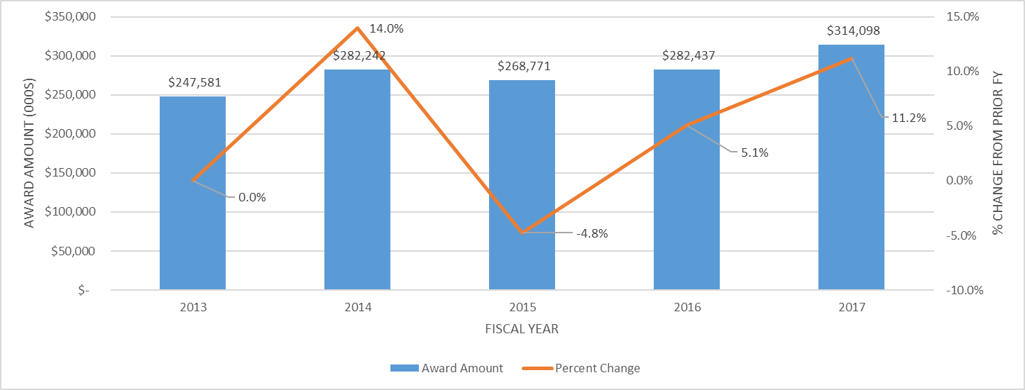
AWARDS (OBLIGATIONS) RECEIVED FROM EXTERNAL SPONSORS – AMOUNT AND PERCENT CHANGE

Slide 23
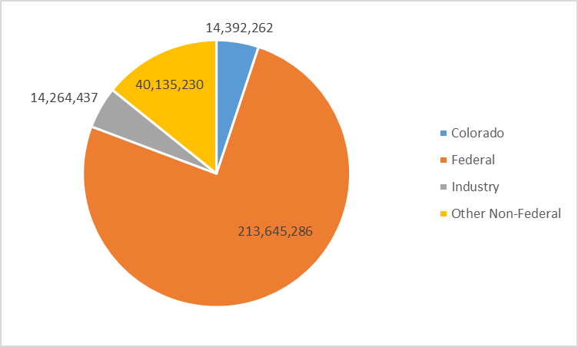
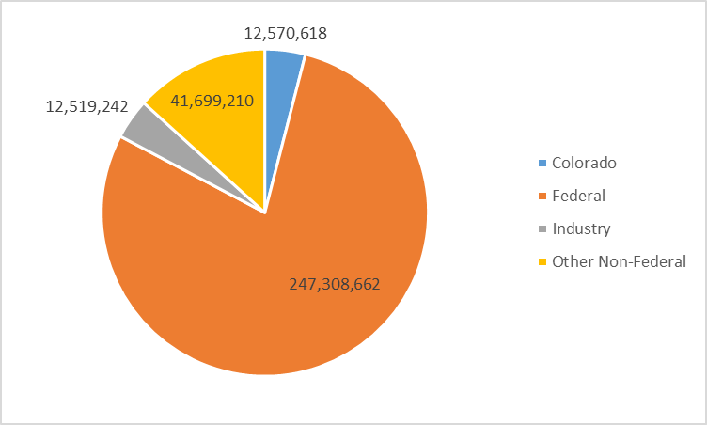
AWARDS (OBLIGATIONS)RECEIVED FROM EXTERNAL SPONSORS
AWARDS BY SPONSOR CATEGORY
FISCAL YEAR 2016
AWARDS BY SPONSOR CATEGORY
FISCAL YEAR 2017

Slide 24
TOP SPONSORS BY SPONSOR CATEGORY
FEDERAL SPONSORS
NON-FEDERAL SPONSORS (OTHER THAN COLORADO OR INDUSTRY SOURCES)

Slide 25
TOP SPONSORS BY SPONSOR CATEGORY
COLORADO SPONSORS
INDUSTRY SPONSORS

Slide 26
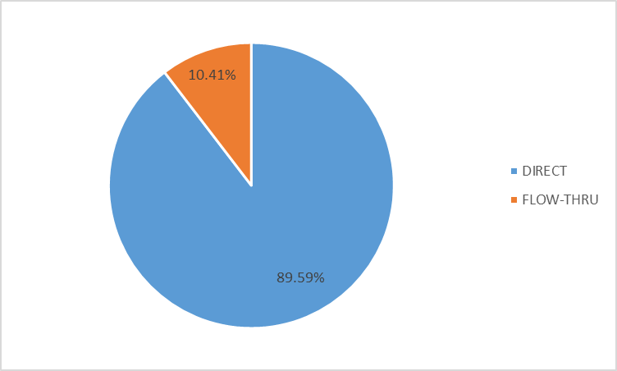
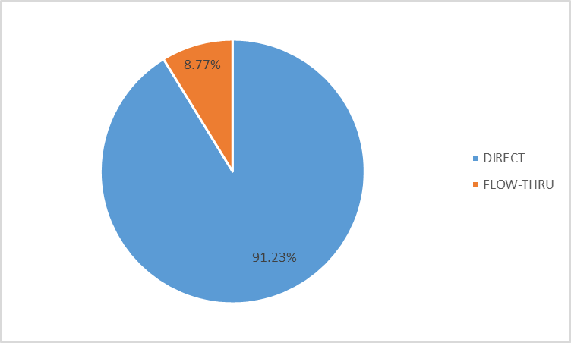
DIRECT RECIPIENT (DIRECT) VS SUBRECIPIENT (FLOW THRU)
FISCAL YEAR 2016
FISCAL YEAR 2017

Slide 27
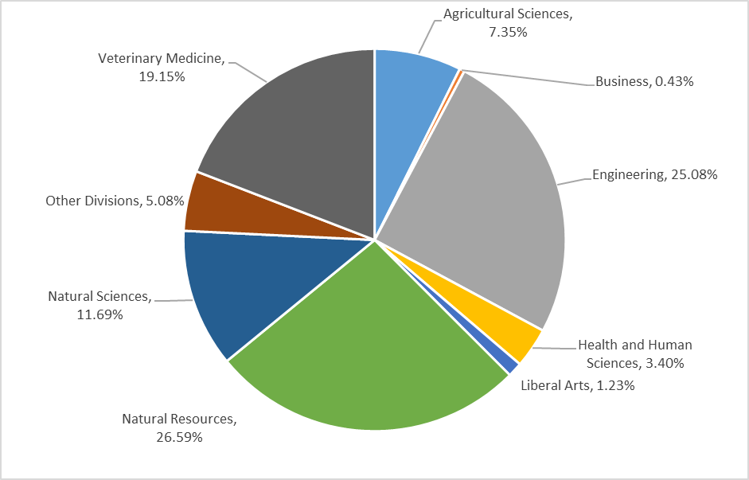
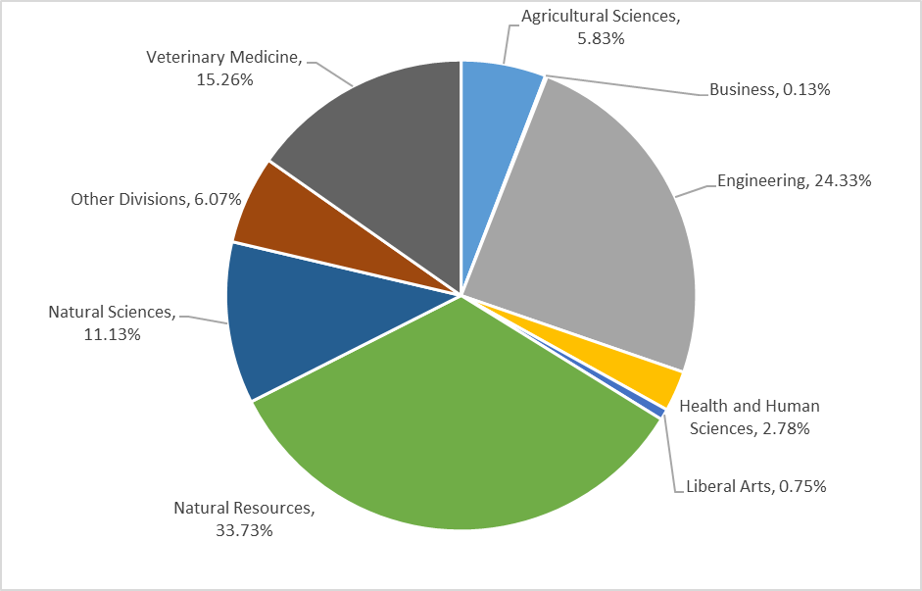
EXTERNAL FUNDING BY COLLEGE FY 2016 AND FY 2017
FY 2016 TOTAL AWARD (OBLIGATED) AMOUNT $282M
FY 2017 TOTAL AWARD (OBLIGATED) AMOUNT $314M

Slide 28
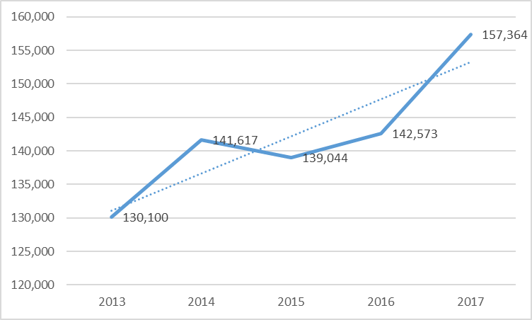
AVERAGE AWARD (OBLIGATED) AMOUNT – ALL SPONSORS

Slide 29
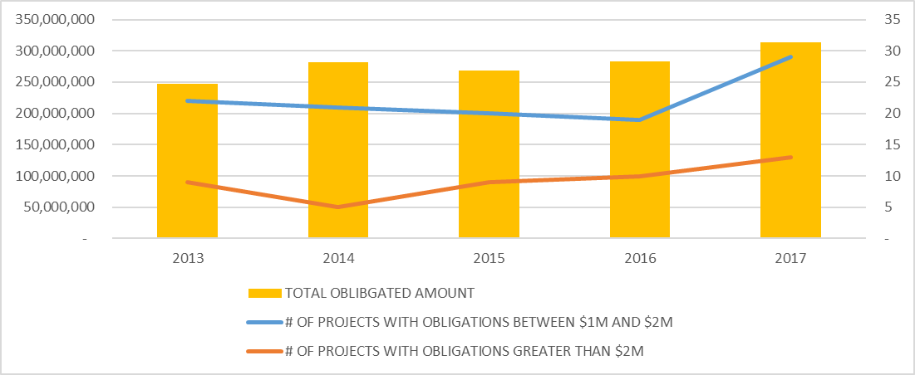
# OF PROJECTS WITH LARGE AWARD(OBLIGATION) SIZE

Slide 30
AWARDS (OBLIGATIONS) RECEIVED BY COLLEGE

Slide 31
AWARDS (OBLIGATIONS) RECEIVED BY THE COLLEGE OF AGRICULTURAL SCIENCES BY DEPARTMENT

Slide 32
AWARDS (OBLIGATIONS) RECEIVED BY THE COLLEGE OF BUSINESS BY DEPARTMENT

Slide 33
AWARDS (OBLIGATIONS)RECEIVED BY THE WALTER SCOTT, JR. COLLEGE OF ENGINEERING BY DEPARTMENT

Slide 34
AWARDS (OBLIGATIONS) RECEIVED BY THE COLLEGE OF HEALTH AND HUMAN SCIENCES BY DEPARTMENT

Slide 35
AWARDS (OBLIGATIONS) RECEIVED BY THE COLLEGE OF LIBERAL ARTS BY DEPARTMENT

Slide 36
AWARDS (OBLIGATIONS) RECEIVED BY THE WARNER COLLEGE OF NATURAL RESOURCES BY DEPARTMENT

Slide 37
AWARDS (OBLIGATIONS) RECEIVED BY THE COLLEGE OF NATURAL SCIENCES BY DEPARTMENT

Slide 38
AWARDS (OBLIGATIONS) RECEIVED BY ALL OTHER DIVISIONS BY DEPARTMENT/DIVISION

Slide 39
AWARDS (OBLIGATIONS) RECEIVED BY THE COLLEGE OF VETERINARY MEDICINE AND BIOMEDICAL SCIENCE BY DEPARTMENT

Slide 40
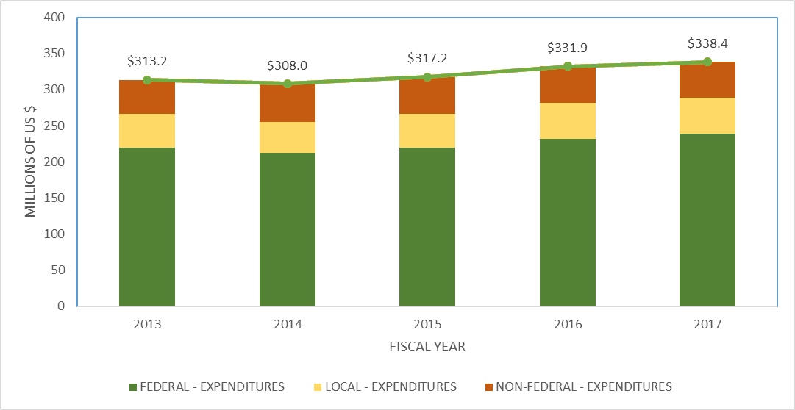
RESEARCH EXPENDITURE SUMMAY BY SOURCE FY 2013 THROUGH 2017

Slide 41
SPONSORED AGREEMENT (53 ACCOUNT) EXPENDITURES BY COLLEGE
FISCAL YEAR 2016
FISCAL YEAR 2017

Slide 42
SPONSORED AGREEMENT (53 ACCOUNT) EXPENDITURES COLLEGE OF AGRICULTURAL SCIENCE BY DEPARTMENT
FISCAL YEAR 2016
FISCAL YEAR 2017

Slide 43
SPONSORED AGREEMENT (53 ACCOUNT) EXPENDITURES COLLEGE OF BUSINESS BY DEPARTMENT
FISCAL YEAR 2016
FISCAL YEAR 2017

Slide 44
SPONSORED AGREEMENT (53 ACCOUNT) EXPENDITURES WALTER SCOTT, JR. COLLEGE OF ENGINEERING (SCOE) BY DEPARTMENT
FISCAL YEAR 2016
FISCAL YEAR 2017

Slide 45
SPONSORED AGREEMENT (53 ACCOUNT) EXPENDITURES COLLEGE OF HEALTH AND HUMAN SCIENCES BY DEPARTMENT
FISCAL YEAR 2016
FISCAL YEAR 2017

Slide 46
SPONSORED AGREEMENT (53 ACCOUNT) EXPENDITURES COLLEGE OF LIBERAL ARTS BY DEPARTMENT
FISCAL YEAR 2016
FISCAL YEAR 2017

Slide 47
SPONSORED AGREEMENT (53 ACCOUNT) EXPENDITURES WARNER COLLEGE OF NATURAL RESOURCES BY DEPARTMENT
FISCAL YEAR 2016
FISCAL YEAR 2017

Slide 48
SPONSORED AGREEMENT (53 ACCOUNT) EXPENDITURES COLLEGE OF NATURAL SCIENCES BY DEPARTMENT
FISCAL YEAR 2016
FISCAL YEAR 2017

Slide 49
SPONSORED AGREEMENT (53 ACCOUNT) EXPENDITURES ALL OTHER DIVISIONS BY DEPARTMENT
FISCAL YEAR 2016
FISCAL YEAR 2017

Slide 50
SPONSORED AGREEMENT (53 ACCOUNT) EXPENDITURES COLLEGE OF VETERINARY MEDICINE AND BIOMEDICAL SCIENCES BY DEPARTMENT
FISCAL YEAR 2016
FISCAL YEAR 2017

