Slide 1
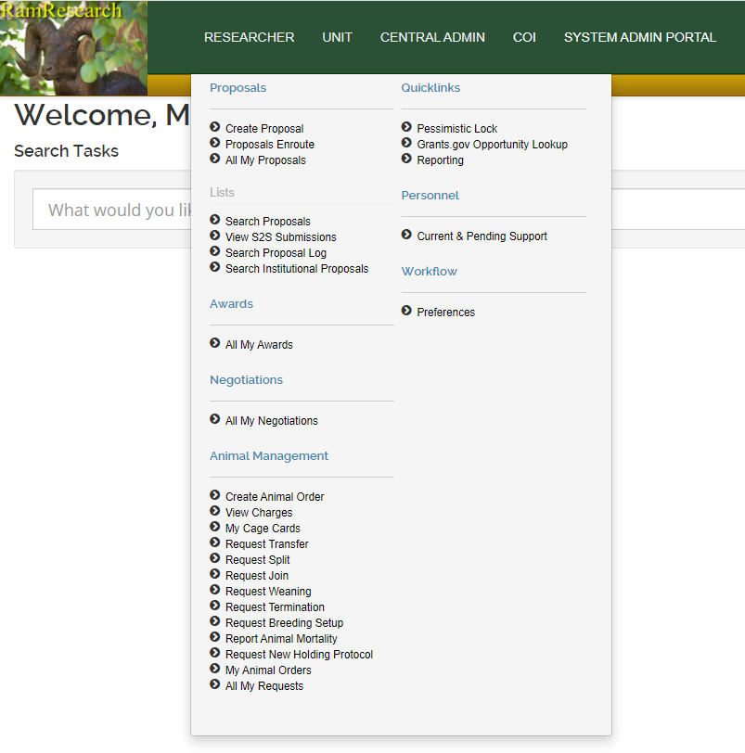
Open the Researcher menu and click the Request Termination option under the Animal Management menu

Slide 2
Select the Effective Date for when the animals were/are to be euthanized
ONLY check the box if you are requesting LAR Technical Services to euthanize the designated animals for you.
The request will route to the LAR Techs and they will change the effective date to reflect when they are able to complete the request
You are still expected to tag the cages in the room to be sacrificed
If you are euthanizing the animal(s) yourself, do NOT check the box

Slide 3
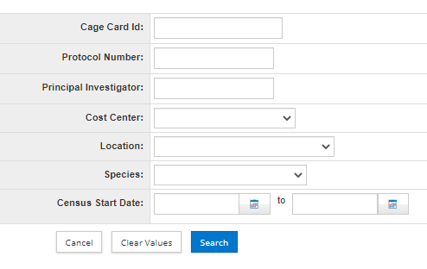
To select the cage cards/animals that will be/have been euthanized:
Click on the magnifying glass next to Cage Card Id under the Current header
This will open a cage card search
If you have a single cage card that needs to be stopped, you can enter in the Cage Card ID into the top field and then select it from the search results
If you have multiple cage cards that need to be stopped, it is easiest to search by the protocol and location, to then select multiple cards from the search results

Slide 4
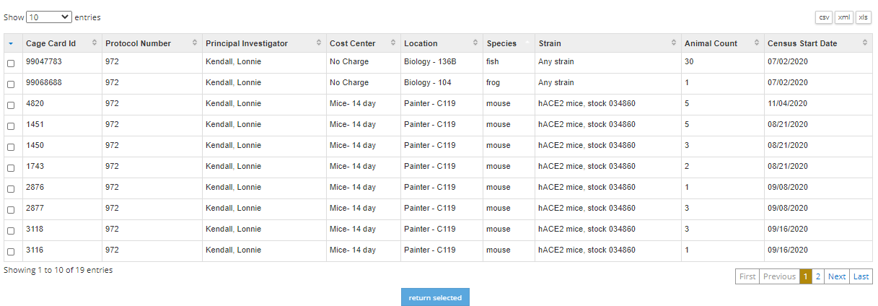
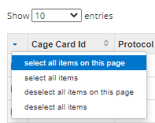
From the Cage Card Search results:
Check the box(es) next to the cage card(s) that need to be part of the request
Then press the Return Selected button at the bottom of the page
If you need to select all cards on a page or in the table, click on the arrow in the top left corner and select the option you need, then press Return Selected

Slide 5
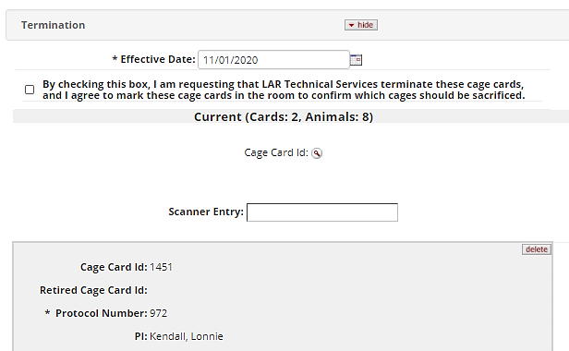
The cage cards you selected will show up in the request now
If you need to add any more cage cards, you can repeat searching for them and returning the selected
If you need to remove any cage card from the request, press the delete button in the upper-right corner of the card in the request

Slide 6
Once the cage card(s) for the animal(s) that need to be euthanized (or that have already been euthanized) are in the request, press the submit button at the bottom of the page
If you requested LAR to euthanize the animal(s) in the cage, the document will be approved once the request has been completed. You will be able to see the status of the request in the All My Requests search
If you have euthanized the animal(s) yourself, it is required that you:
Write the termination date on the cage card(s), and
Scan in the cage card(s) to the LAR animal census email OR turn in the physical cage card(s) to the closest terminated cage card drop box

Slide 7
Notes:
Cage cards can still be turned in to the Painter front desk without having to put in a termination request online. LAR business office staff will stop census on the cage cards
You must write the termination date on the cage cards when turning them in or scanning them in
Cage cards without a termination date written on them will be stopped on the date they are received

Slide 8
If you have any questions, please reach out to:
Megan Fritz
MeganR.Fritz@colostate.edu
(970)491-6012
Last Updated: 11/19/2020

