Slide 1
Holding Protocol
A holding protocol in KAM acts as a temporary protocol to be used only in special circumstances to avoid noncompliance with Sponsored Programs and IACUC policy.
No research activities can occur on a holding protocol.
A Holding Protocol should only be created if:
An IACUC protocol has expired and there are animals on census at the time of expiration
Extenuating circumstances as determined by LAR and IACUC staff

Slide 2
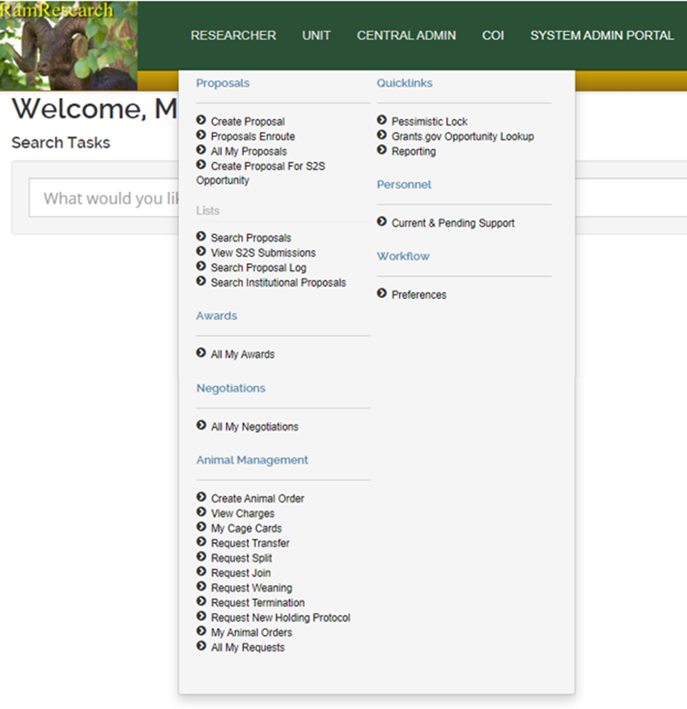
Open the Researcher menu and click the Request New Holding Protocol option under the Animal Management menu

Slide 3
In the Basic Info section:
Copy the title of the protocol that has expired into the Title field
Enter in the expired protocol number into the Legacy ID field
In the Justification field, explain why this holding protocol is necessary

Slide 4
In the Protocol Personnel section:
Begin typing the PI’s name and select the name from the drop down that appears
Choose a Protocol Role for the individual
Click the “add” button on the far right side of the row
Repeat as many times as needed to add the personnel who will need access to this holding protocol

Slide 5
In the Protocol Species section:
Choose the species needed from the drop down menu
Do NOT check the USDA Regulated checkbox unless you are certain the species is a USDA species
Enter in the Number Allowed; this is the number of animals that need to be on this holding protocol temporarily
Press the “add” button on the far right side of the row
Add as many species as necessary for this holding protocol

Slide 6
Once completed, click on “Save” at the bottom of the request
The page will reload and alert you if there are any errors; if there are no errors, the options at the bottom will now include “Submit”
“Submit” the holding protocol request and take note of the holding protocol number in the top right of your screen (this will be a “H” protocol number)
“Close” out of the document
When the protocol is approved, you will receive an email from LAR on how to proceed

Slide 7
Notes:
Holding protocols will always be routed to LAR for approval
A fee will be applied for the creation and utilization of holding protocols
LAR recommends that labs check census regularly and submit all protocol renewals/amendments in a timely fashion to avoid this fee
Holding Protocols will expire 30 days after creation
If animals continue to remain on the holding protocol past 30 days, the holding protocol fee will be charged again
Cages that are placed on a holding protocol will be tagged with a yellow cage card; this cage card will only be removed once the animals are no longer on the holding protocol
Once the new IACUC protocol is approved, a transfer request must be submitted to move animals off of the holding protocol to resume research activities

Slide 8
If you have any questions, please reach out to:
Megan Fritz
MeganR.Fritz@colostate.edu
(970)491-6012

